Slide 1

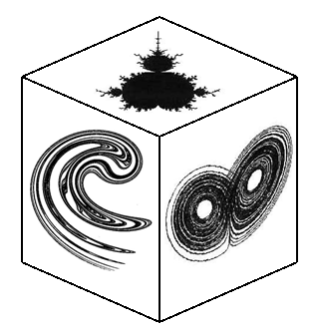


*
Móstoles, Madrid, Spain
Exploring Noisy Hamiltonian Dynamics
Miguel A. F. Sanjuán
Nonlinear Dynamics, Chaos and Complex Systems Group
Dept. of Physics, Universidad Rey Juan Carlos, Madrid, Spain
Notes:
1

Slide 2



Slide 3
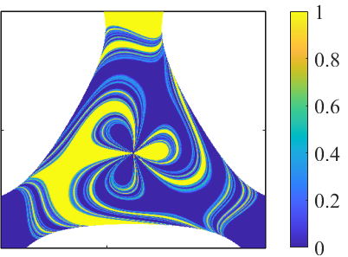

Slide 4
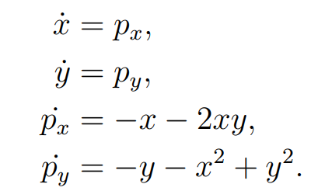
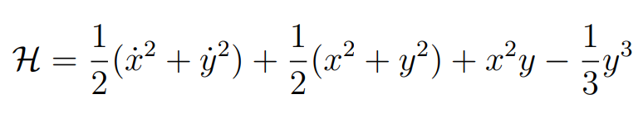
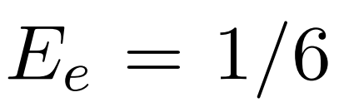
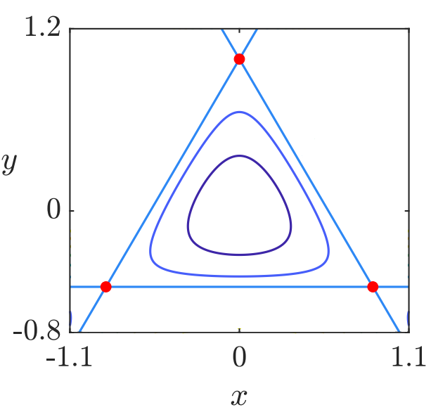
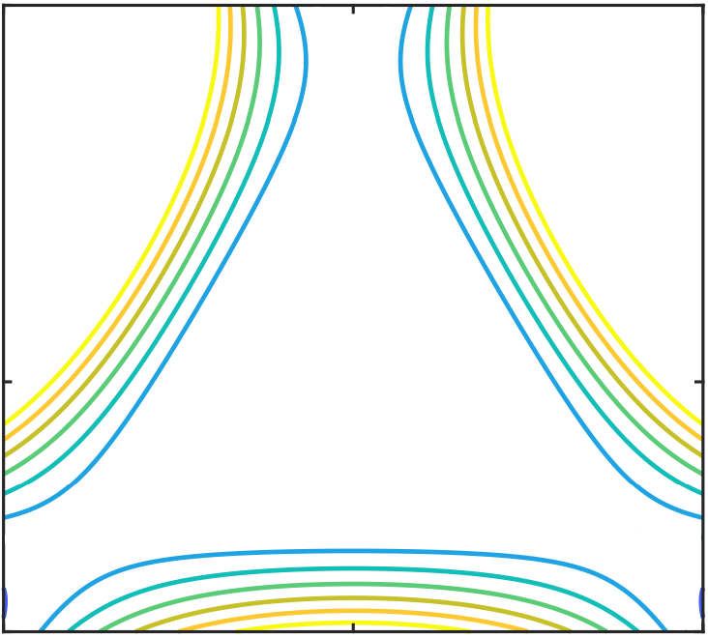


Introduction to 2D open Hamiltonian Systems:
The Hénon-Heiles Hamiltonian
Escape energy
$$E≤1/6$$
$$E>1/6$$
Exit 1
Exit 2
Exit 3
M. Hénon and C. Heiles. The applicability of the third integral of motion. Astron. J. 69, 73-79 (1964)

Slide 5
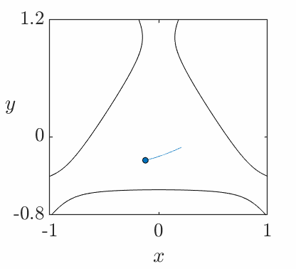

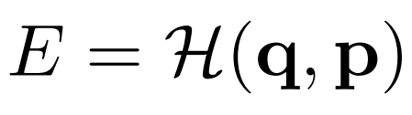
Transient chaos in a 2D open Hamiltonian system
Transient chaotic motion of a particle under the influence of a potential that exhibits “exits”.
Chaotic dynamics occurs due to the existence of a chaotic saddle in the phase space
Transient caos

Slide 6
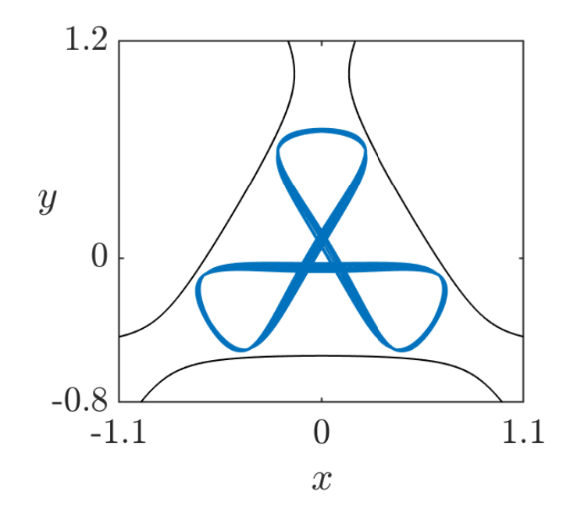
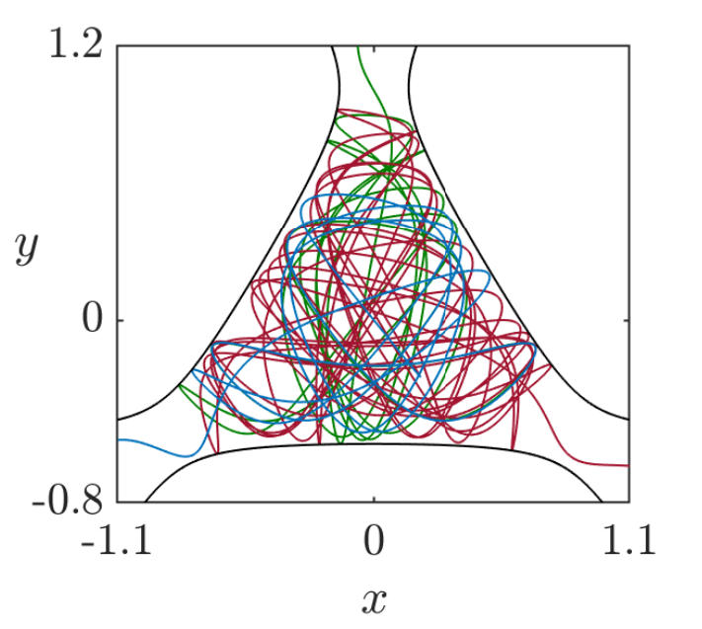
Hyperbolic and Nonhyperbolic Dynamics
Depending on the energy, the global escape dynamics is different
Nonhyperbolic
Hyperbolic
Stable periodic orbits (PO) exist
There are trapped trajectories inside Kolmogorov-Arnold-Moser (KAM) islands
Chaotic trajectories are affected by the stickiness of KAM islands
All PO are unstable
There are no KAM islands
All initial conditions lead to escaping trajectories

Slide 7
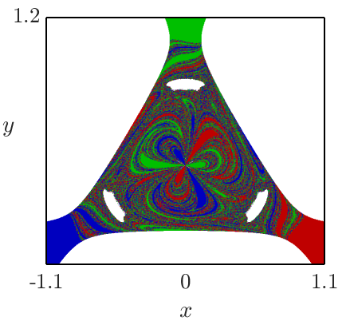
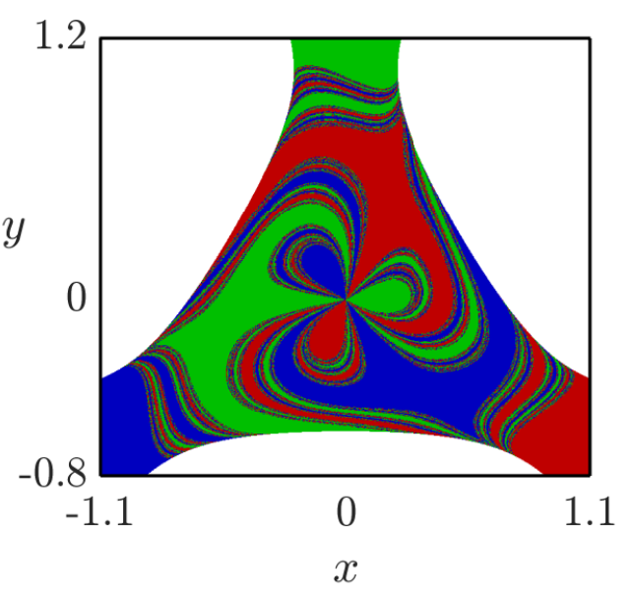


Exit basins of the Hénon-Heiles Hamiltonian
$$E=0.19$$
Nonhyperbolic
$$E=0.25$$
Hyperbolic

Slide 8
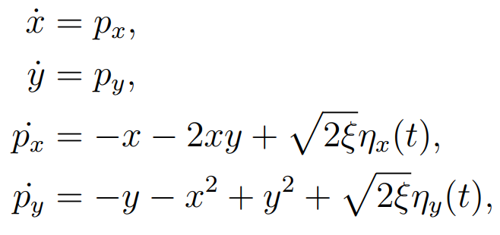
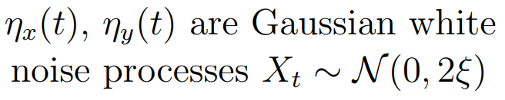
Noise in the Hénon-Heiles Hamiltonian
Gaussian white noise

Slide 9
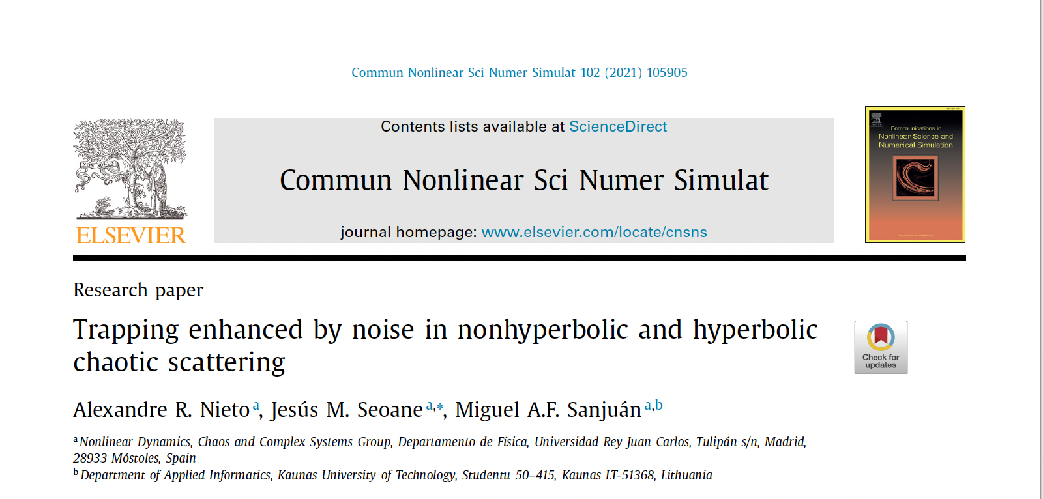
Noise-enhanced trapping in open Hamiltonian systems

Slide 10
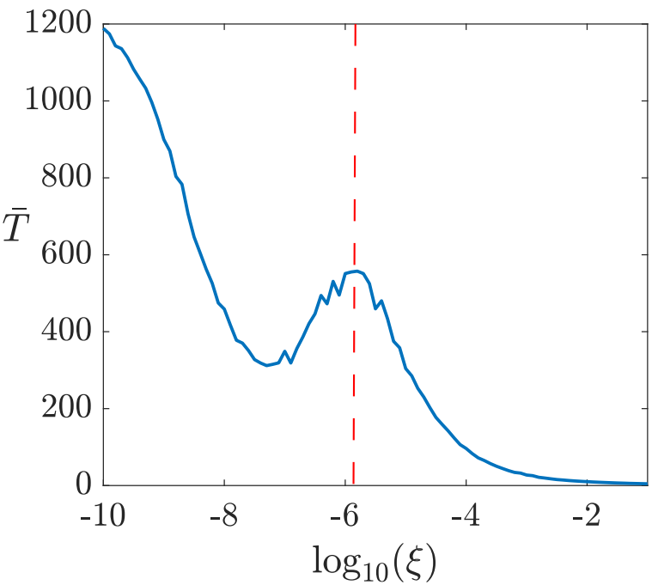
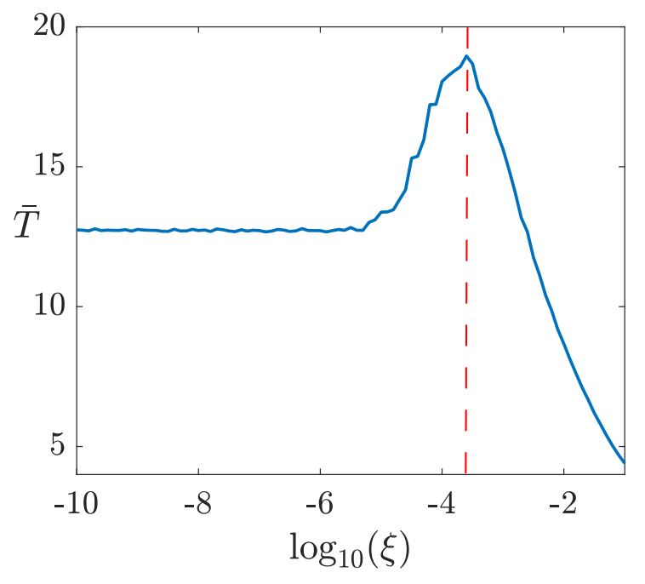





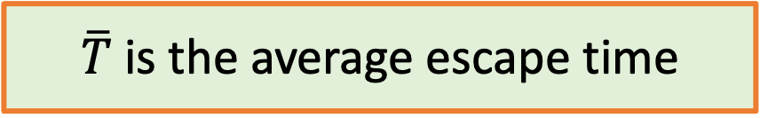

Noise-enhanced trapping
$\overline{T}$is the average escape time
$$E≥1/6$$
Nonhyperbolic
Hyperbolic
$$E=0.18$$
$$E=0.25$$
Gradual reduction of stickiness
$$ξ_{t}$$
$$ξ_{t}$$
$$ξ_{t}$$

Slide 11
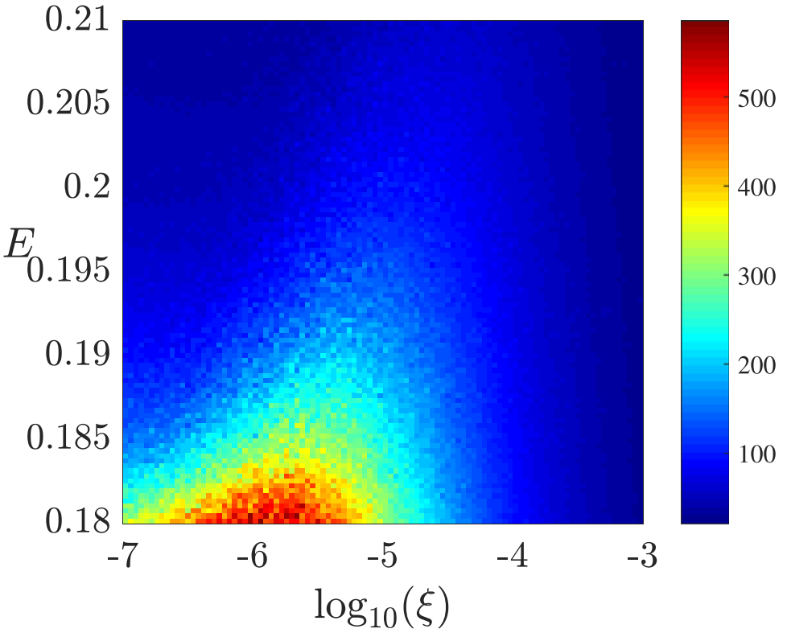



Nonhyperbolic regime: The value of $ξ_{t}$ increases with the energy E
Nonhyperbolic
$$\overline{T}$$
$$ξ_{t}$$

Slide 12
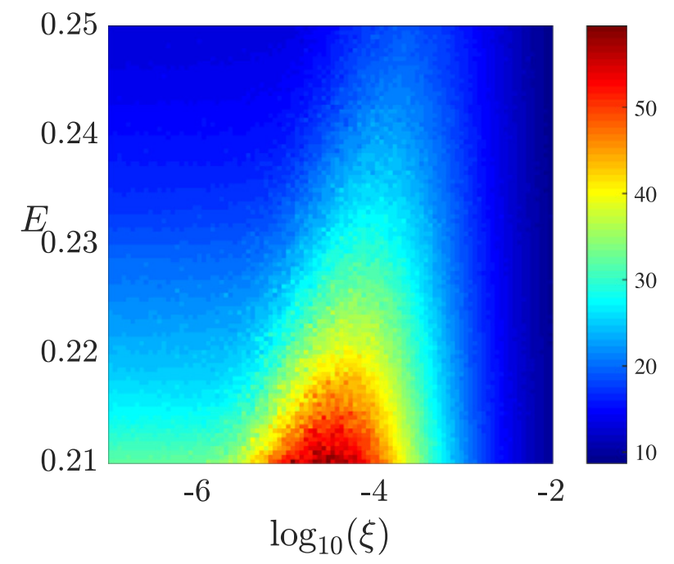



Hyperbolic regime: The value of $ξ_{t}$ increases with the energy E
Hyperbolic
$$\overline{T}$$
$$ξ_{t}$$

Slide 13
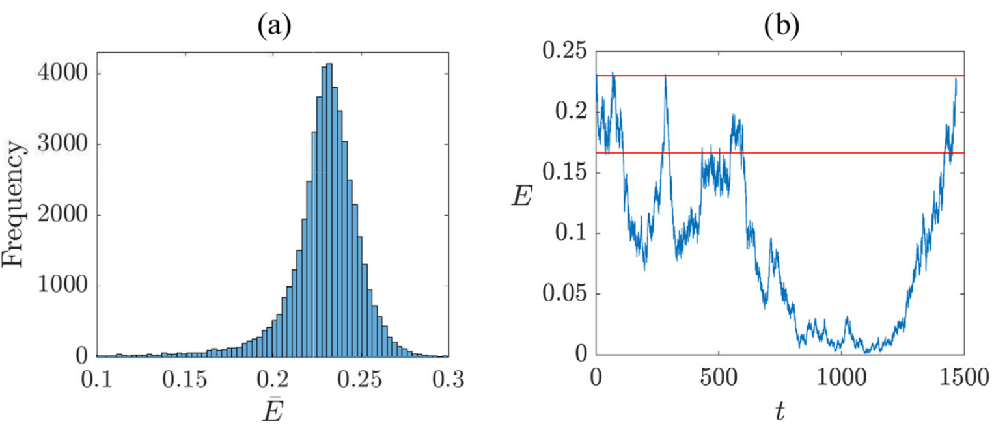

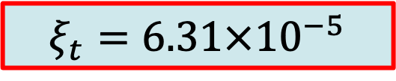

Why does noise-enhanced trapping occur?
$$E=0.23$$
$$ξ_{t}=6.31×{10}^{−5}$$
$$Unusual trajectories decrease their energy and remain$$
$$in the scattering region during long transients.$$

Slide 14

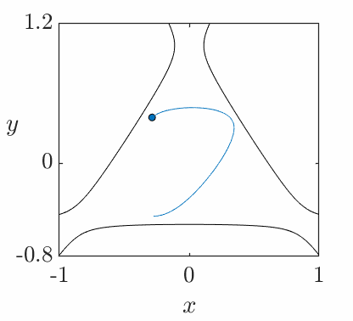
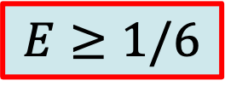

Noise-enhanced trapping for $ξ_{t}$
$$E≥1/6$$

Slide 15

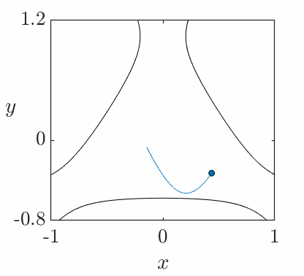
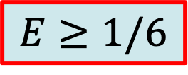
Dynamics for low noise intensity
$$E≥1/6$$

Slide 16

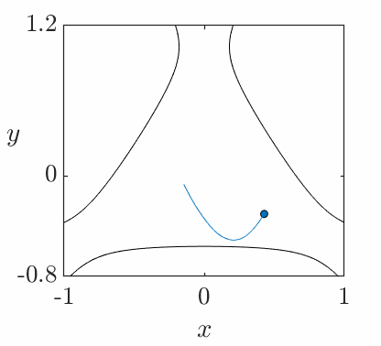
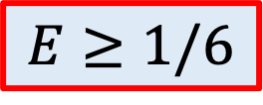
Dynamics for high noise intensity
$$E≥1/6$$

Slide 17
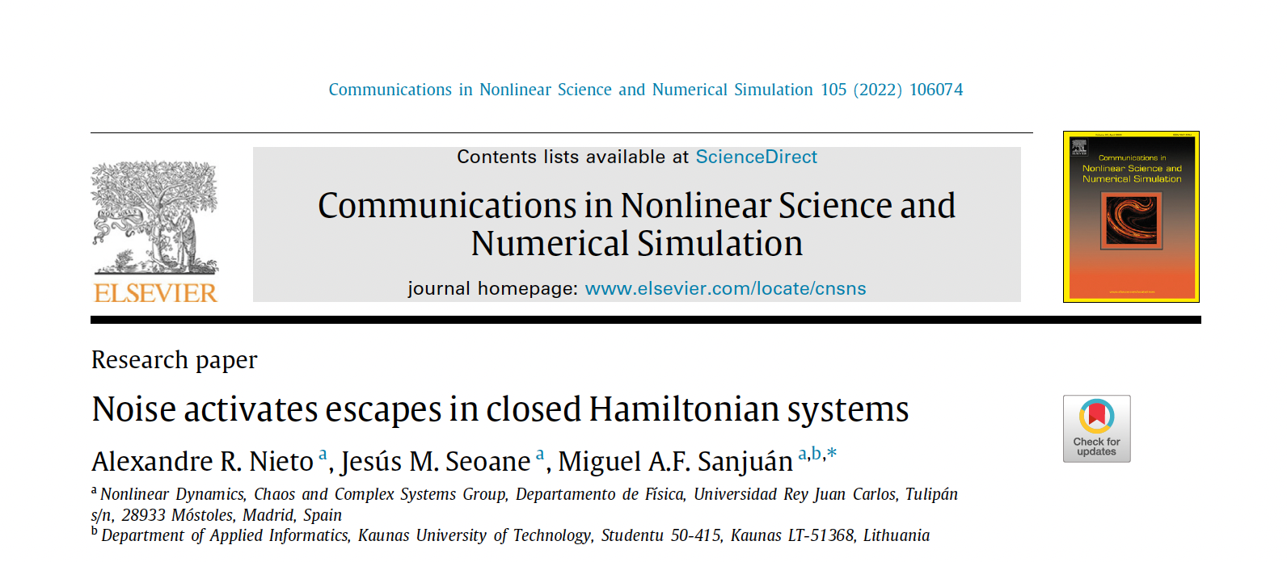
Noise activates escapes in closed Hamiltonian systems

Slide 18
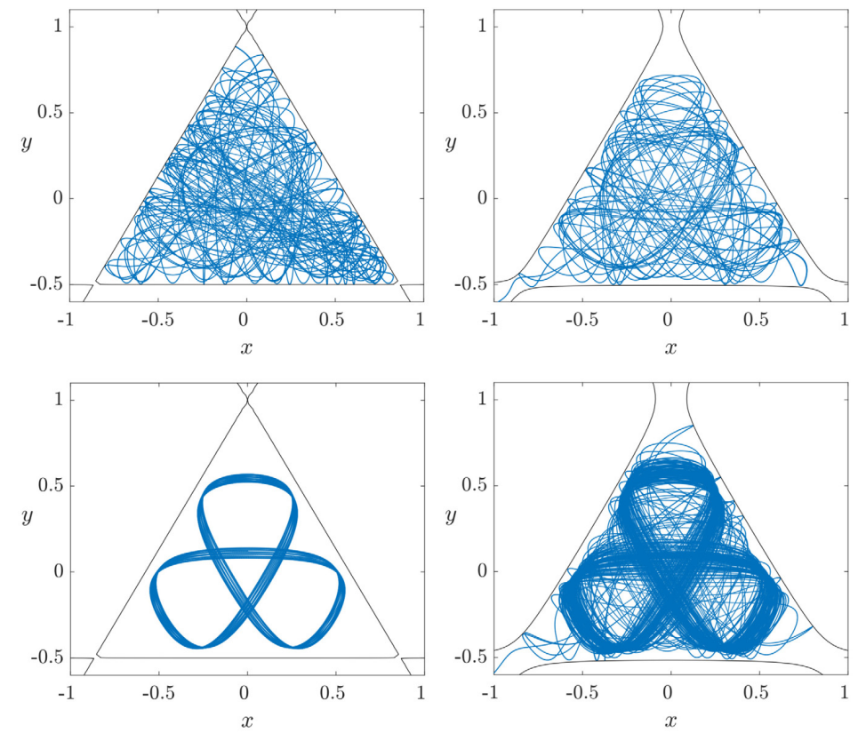
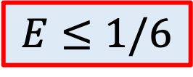
Effects of noise in the closed regime
Due to the energy fluctuations, the isopotential curves open and the particles eventually escape.
$$E≤1/6$$
Noiseless
With noise

Slide 19
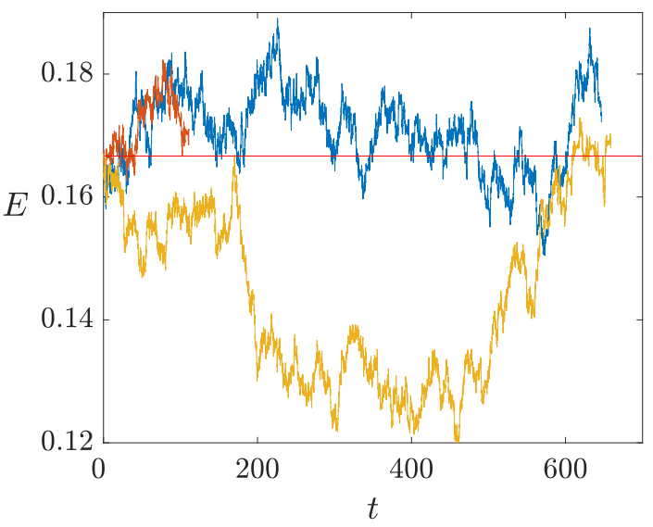
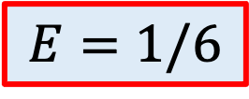

Evolution of the energy of three simulations starting at the same initial condition with $ξ=10^{−6}$
$$E=1/6$$

Slide 20
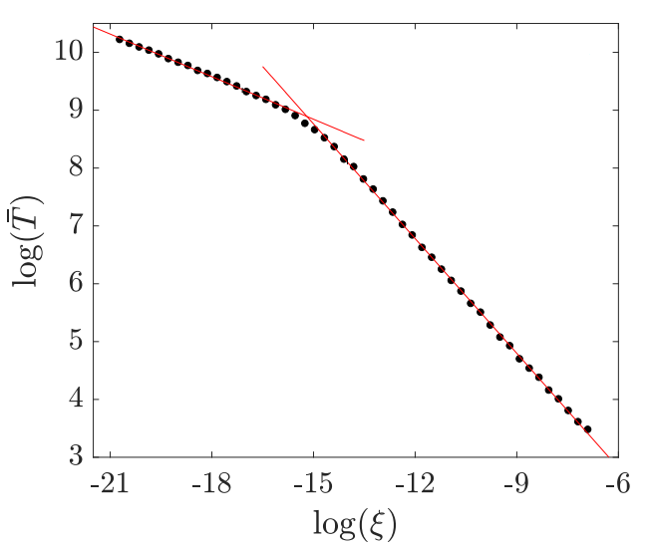
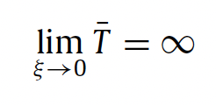

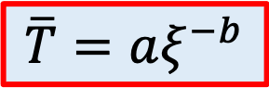
The evolution of the average escape time is explained by two different algebraic scaling laws
$$\overline{T}=aξ^{−b}$$

Slide 21
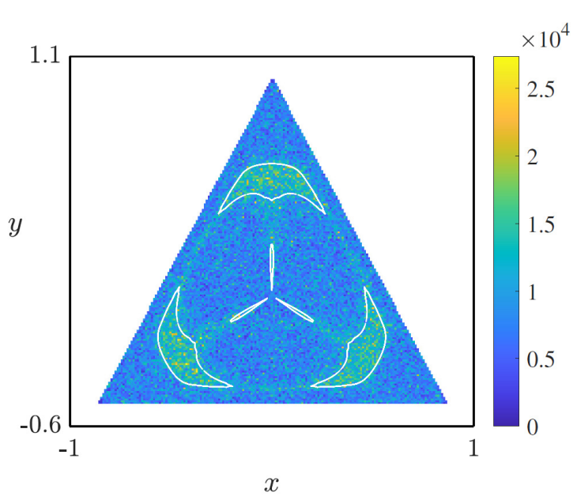

Initial conditions within the KAM islands of the deterministic system have higher average escape time
Stickiness influences the escape dynamics
$$\overline{T}$$
Low noise
KAM

Slide 22
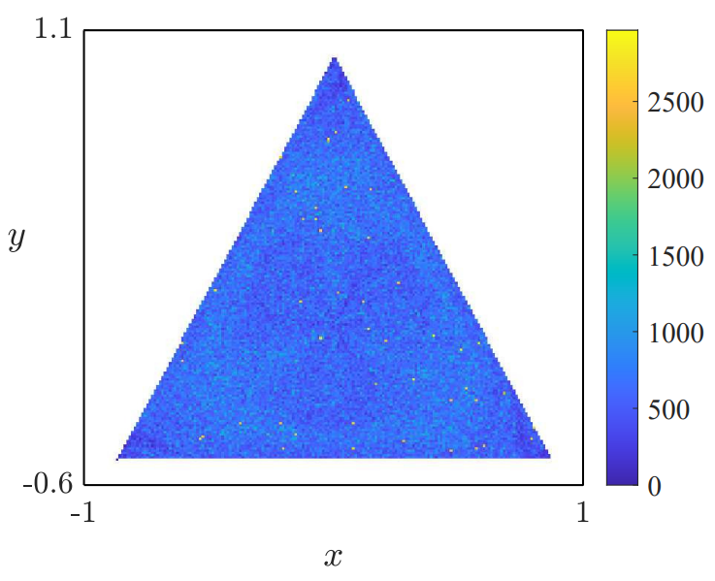

Roughly uniform average
escape time distribution
Stickiness does not influence the escape dynamics
$$\overline{T}$$
High noise

Slide 23
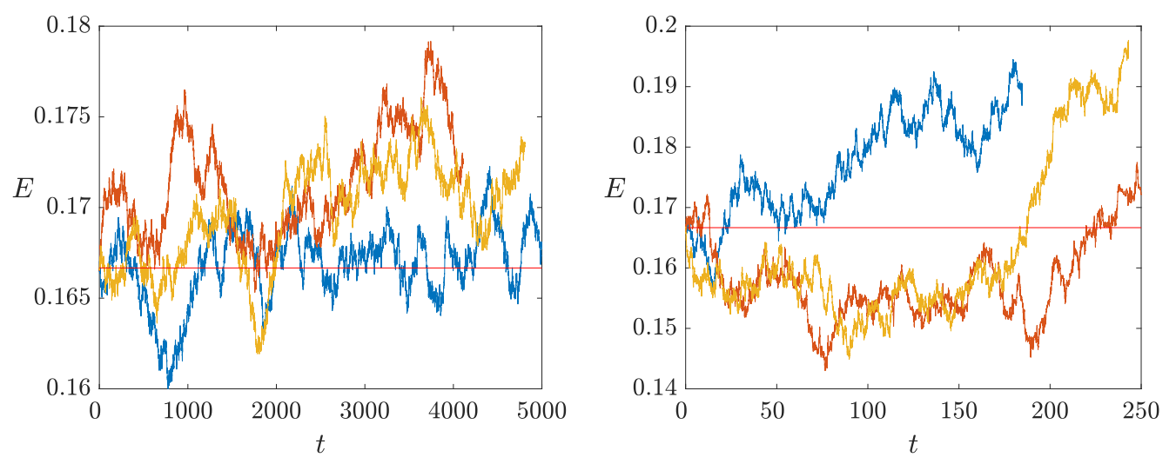



Energy evolution of different launchings of the same initial condition that belongs to a KAM island in the noiseless system
$$E=1/6$$
$$ξ={10}^{−7}$$
$$ξ={10}^{−5}$$
Obviously, the escape time is much larger on the left.
Trajectories of the E(t) are not drawn after the escape.

Slide 24
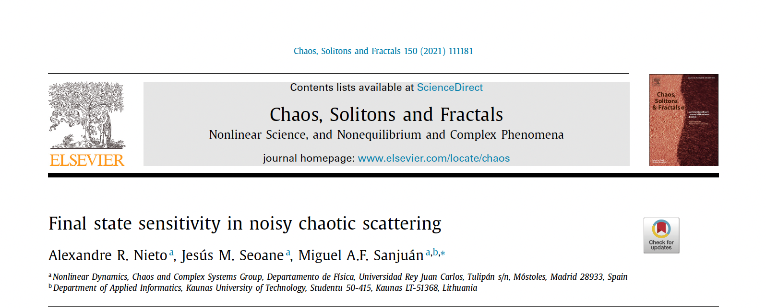
Final state sensitivity in noisy chaotic scattering

Slide 25
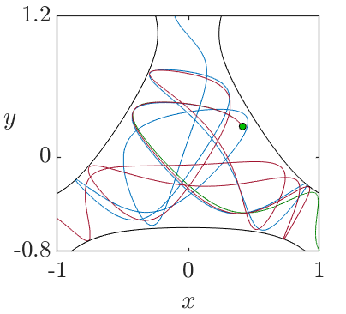
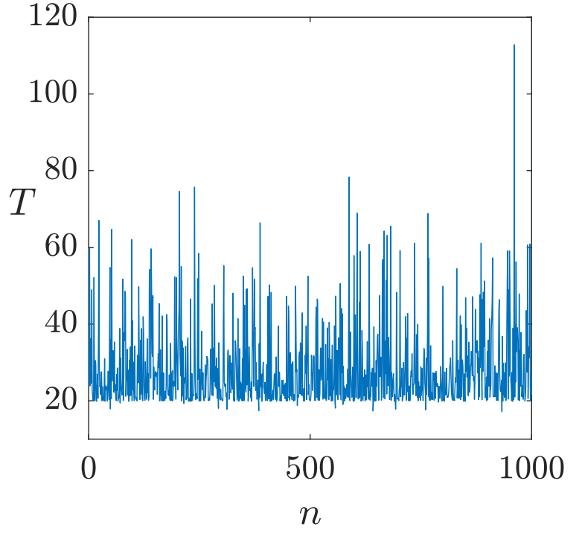
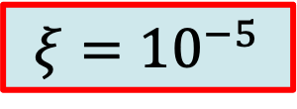

Trajectories starting from the same IC close to the fractal boundary can escape through different exits
$$E=0.25$$
$$ξ={10}^{−5}$$
The ideas of unpredictability associated to noiseless systems, such as Exit Basins and Uncertainty Exponent are no longer useful

Slide 26
Probability Basin

Slide 27
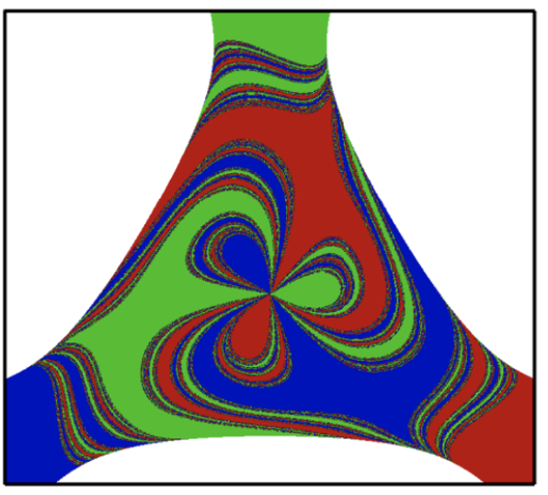
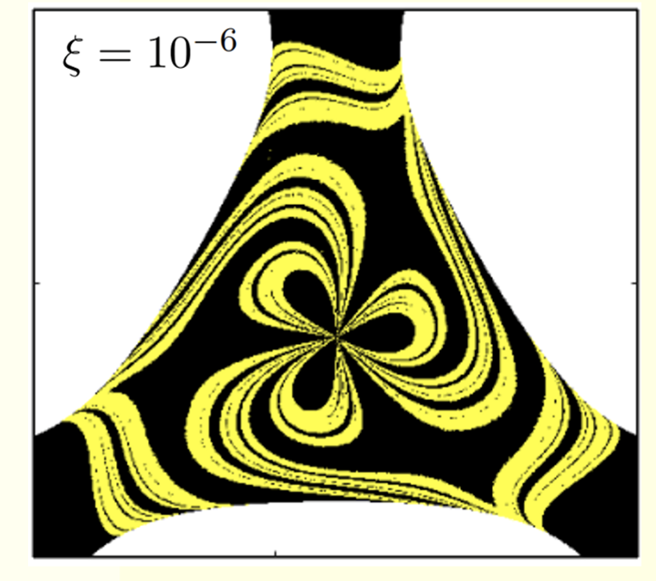
Uncertainty Noisy Basins (I)
Exit Basin in the noiseless system
Uncertainty Basin in the noisy system

Slide 28
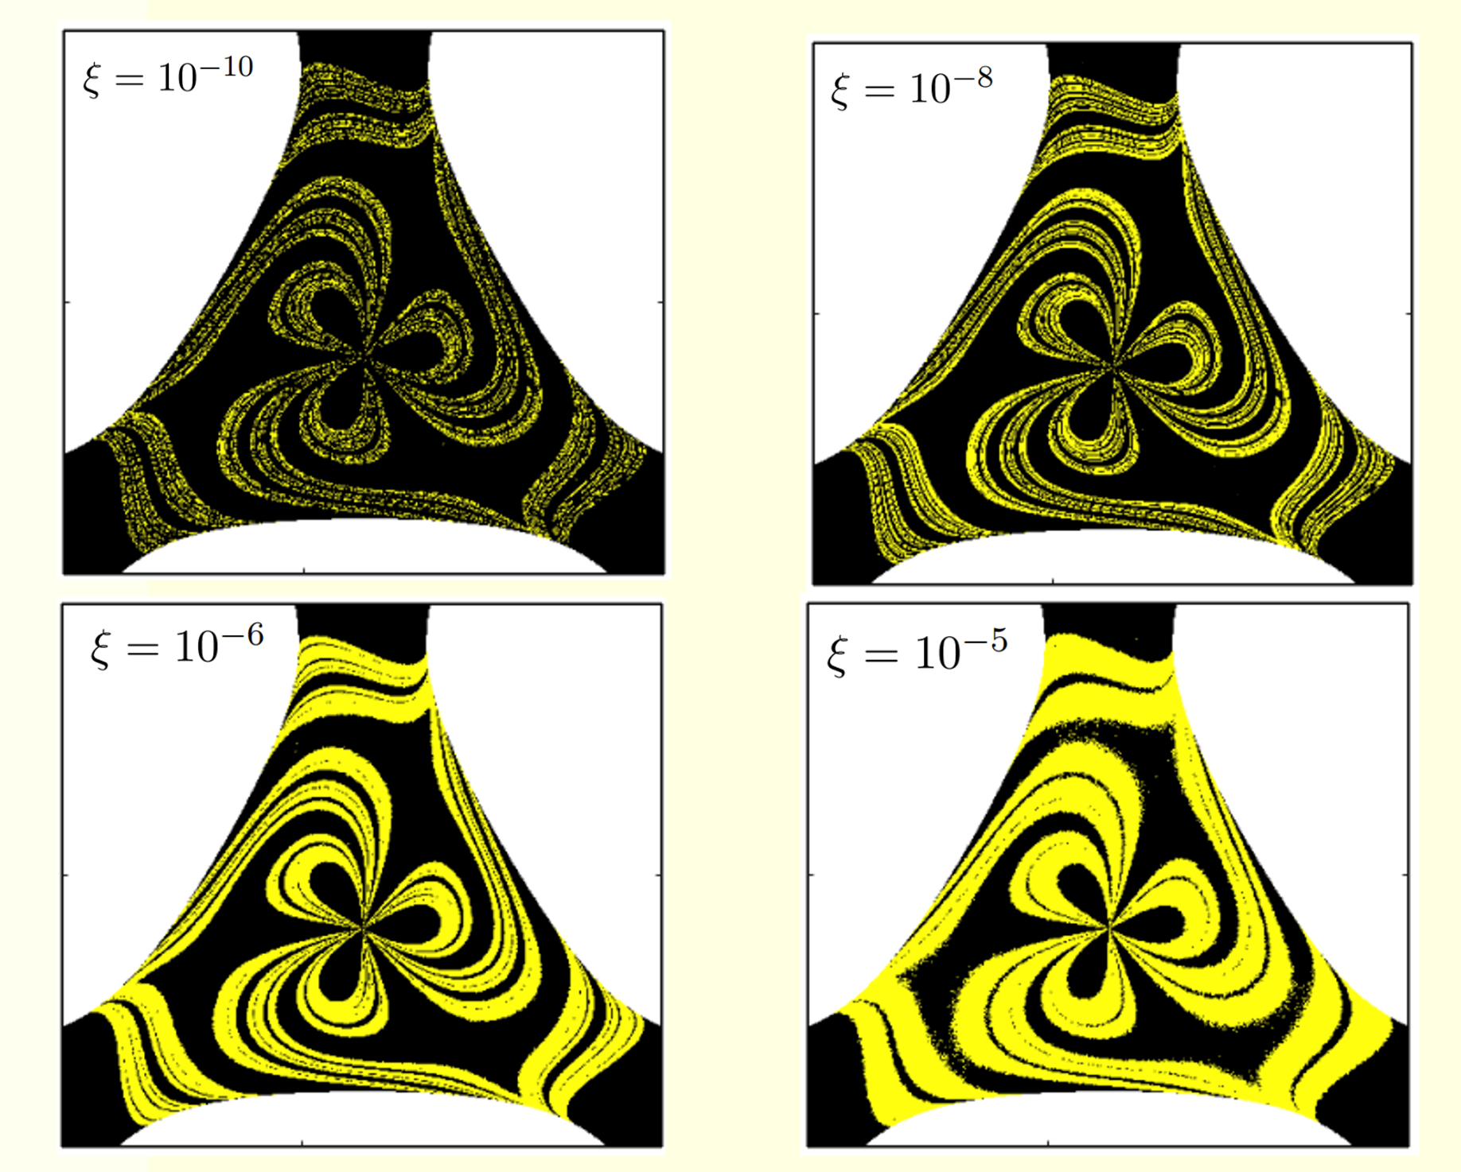
Uncertainty Noisy Basins (II)

Slide 29
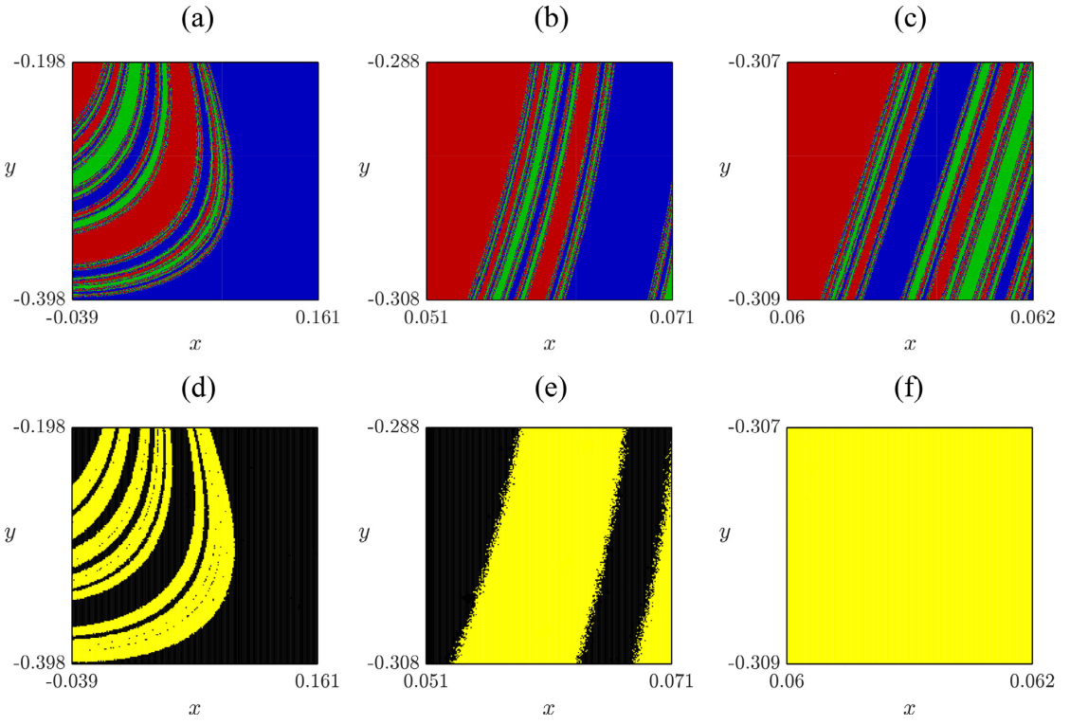
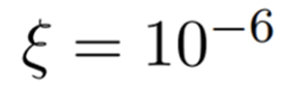

The uncertainty basin grows from the exit basin boundary, connecting different regions and generating a smooth geometry
$$E=0.25$$
This implies that the size of the uncertainty basin is independent of its resolution, which allows to establish an absolute fraction of uncertain initial conditions.

Slide 30





Unpredictability and fractal boundaries in the noiseless case: uncertainty dimension
α < 1
Smooth Boundary
Fractal Boundary
$$f\sim ε$$
α = 1
$$f\sim {ε }^{α}$$
$f:$Fraction of uncertain initial conditions $ε:$ Resolution
$α:$Uncertainty dimension
C. Grebogi, S. W. McDonald, E. Ott and J. A. Yorke, Final state sensitivity: An obstruction to predictability, Phys. Letters 99A: 415-418 (1983).

Slide 31




Noise-sensitivity exponent
$$β→0 high sensitive to noise$$
$$β≫0 low sensitive to noise$$
The noise-sensitivity exponent is similar to the uncertainty exponent for noisy systems

Slide 32
Summary and Conclusions
A noise-enhanced trapping phenomenon occurs in noisy open Hamiltonian systems. Some trajectories decrease their energy due to the stochastic fluctuations and spend very long transients before finally escaping.
Noise can generate escapes in closed Hamiltonian systems. Noise changes the energy to trajectories below the escape energy.
To better understand the unpredictability in noisy Hamiltonian systems, we have developed different methods and concepts, like the probability basins, uncertainty basins and the noise-sensitivity exponent.

Slide 33
Thank you for your attention
miguel.sanjuan@urjc.es
A. R. Nieto, J. M. Seoane, and M. A. F. Sanjuán. Trapping enhanced by noise in nonhyperbolic and hyperbolic chaotic scattering. Commun. Nonlinear Sci. Numer. Simul. 102, 105905 (2021)
A. R. Nieto, J. M. Seoane, and M. A. F. Sanjuán. Noise activates escapes in closed Hamiltonian systems. Commun. Nonlinear Sci. Numer. Simul. 105, 106074 (2022)
A. R. Nieto, J. M. Seoane, and M. A. F. Sanjuán. Final state sensitivity in noisy chaotic scattering. Chaos Solit. Fractals. 150, 111181 (2021)

