Slide 1

Edge Dynamics in Strongly Nonlinear SSH Photonic Lattices: Reconstructing Bulk-Edge Correspondence
Maluckov
K. Bugarski, R. Vicencio, M, Johansson

Slide 2
Motivation
Nonlinearity challenges foundational principles of topological physics: bulk-boundary correspondence, quantized invariants, and unidirectional edge states.
Mathematically, nonlinearity modifies the energy operator and induces mode mixing, altering the spectrum.
We explore whether approximate bulk-edge correspondence can persist in the fully nonlinear regime of the saturable SSH photonic lattice.

Slide 3
Talk overview:
Introduction
II. Model Equations and Methods
Nonlinear SSH lattice
Zak phase computation methods
III. Nonlinear Edge Modes
Nonresonant vs. resonant regimes
Dynamical bulk/edge excitations and topology
IV. Summary

Slide 4
I INTRODUCTION
Nonlinearity breaks linear superposition, reshapes spectra, and induces instabilities (MI) [1,2,3].
Prior work focused on weakly nonlinear or Floquet-driven systems.
The Su–Schrieffer–Heeger (SSH) model * is ideal for exploring topology+nonlinearity in 1D:
Nonlinear couplings: induce band gaps and topological transitions [7].
On-site nonlinearities: generate gap solitons and edge-localized modes [8]
Saturable nonlinearities:
restore linear behavior in low/high amplitude limits [9]
*SSH originally denote the spinless fermions hopping on a one-dimensional lattice with staggered hopping amplitudes [6]

Slide 5


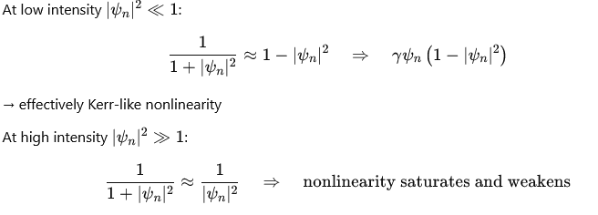
*Cubic nonlinearity: nonlinear term is proportional to the local intensity ∣ψ_{n}∣²
Example: NLS with cubic NL
Saturable nonlinearities [9] introduces asymptotic linear regimes at both low and high intensities.
* On-site nonlinearities

Slide 6

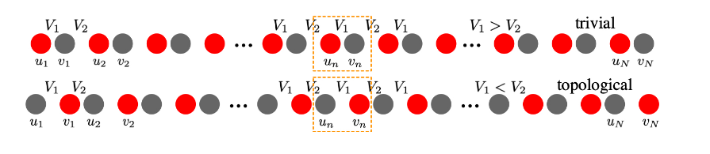
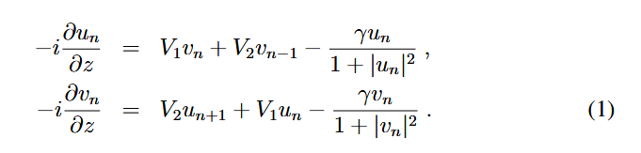


II Model equations and methods
1D bipartite SSH waveguide lattice with dimerized coupling (2 sublattices; 2-site unit cell)
Chiral symmetry implied by bipartite structure (no on-site terms)
$$Γ=\left(\begin{matrix}I_{N} & 0 \\ 0 & −I_{N}\end{matrix}\right)$$
$$I_{N}$$
NxN unity matrix
Model equations:
t=V₁ /V₂ - dimerization strength
γ-nonlinearity strength

Slide 7
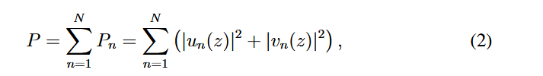
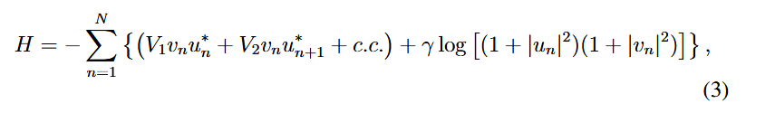

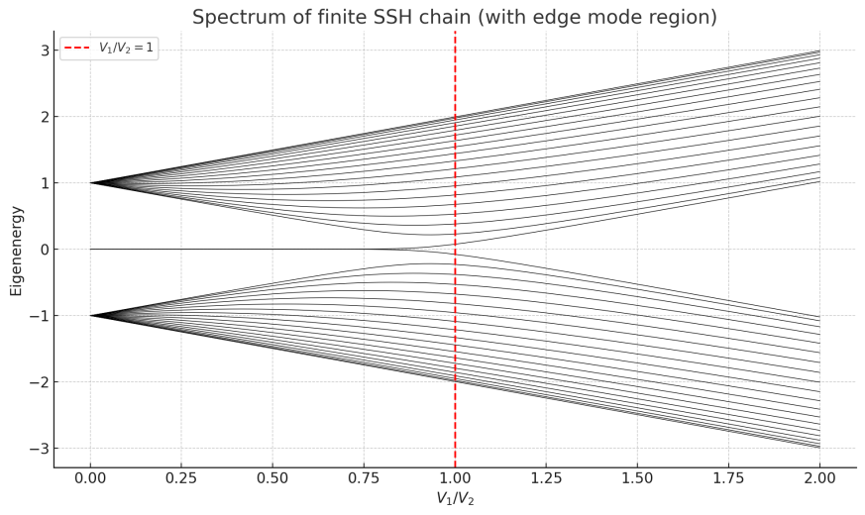

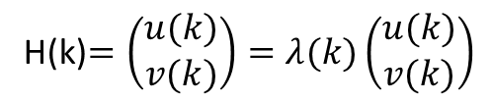

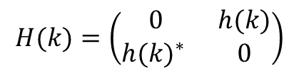
Conserved quantities:
k-space linear Hamiltonian:
$$H(k)=\left(\begin{matrix}0 & h(k) \\ {h(k)}^{∗} & 0\end{matrix}\right)$$
$$h\left(k\right)=d_{x}\left(k\right)−id_{y}\left(k\right)$$
h(k)=V₁ + V₂e^{-ik}
H(k)$=\left(\begin{matrix}u(k) \\ v(k)\end{matrix}\right)=λ(k)\left(\begin{matrix}u(k) \\ v(k)\end{matrix}\right)$

Slide 8

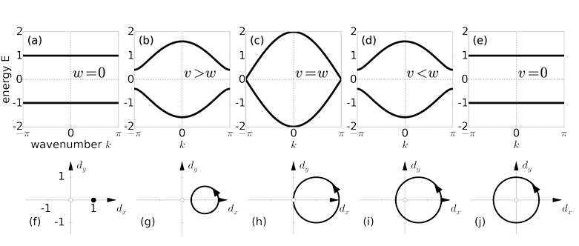
Zak phase (winding number) defined via geometric phase accumulation across Brillouin zone [11]:
=1, t<1
λ
V₂=0
t>0
t=1
t<1
V₁=0
Fig. 1
the number of times d(k) intersects a curve from (d_{x},d_{y})=(0,0) to infinity ⬅➔
k=0→ 2π, the endpoint of d(k) traces out a circle of radius V₂ centered at (V₁ ,0)

Slide 9


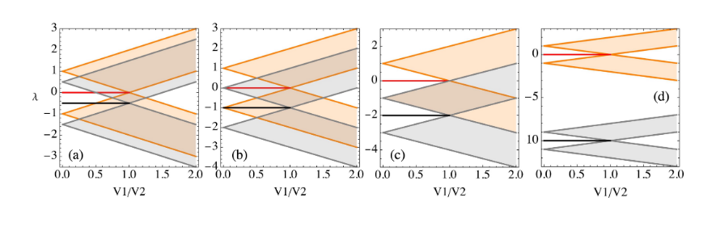
Low vs. high amplitude limit (infinite system, Bloch ansatz):
vs.
Fig. 2: Linear SSH spectrum: Orange (gray) - the high (low) amplitude linear bands . Boundary lines of lower and higher bands are noted as B1L, B1H and B2L, B2H in the following.
γ = 0.5, (b) γ = 1, (c) γ = 2, and (d) γ = 10. (a)-(d) zero-edge modes for t<1, NEM – at -γ.

Slide 10

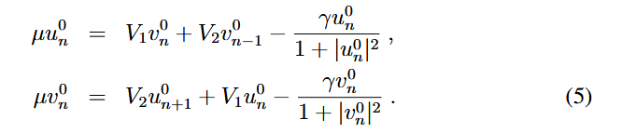
Linear edge modes (LEM): mid-gap states, protected, robust in t<1 regime
→ Nonlinear edge modes (NEM): require numerical continuation, may undergo bifurcations
Stationary solution :
μ–propagation constant/characteristic frequency
Solving NL eigenvalue equation:

Slide 11
Continuation - Newton-Raphson (NR) method
seed for low level of powers and for µ ≳ −γ, fixed γ to convergence ➔ NEM
(i) LEM :
(6)
(ii) µ increases in small steps→ a family of NEM for each fixed t and γ.
Stability of NEM: the linear stability analysis ( LSA) and/or dynamical simulations
LSA: eigenvalue spectrum of perturbations
1) NEM + small complex perturbation;
2) Evolution +linearization;
3) Evolution matrix -- the instability eigenvalues (IEV) and eigenvectors.
IEV - complex numbers: real number pairs or quartets of complex numbers (±z, ±z∗)

Slide 12
General findings [10]:
NEM/NLM (edge/bulk) remains exponentially localized as long as resonances with linear bands are avoided
= TAIL dependence: NEM at tail region resonates with some extended (dispersive band) state→ phase structure of tail changes;
higher μ → tail and power grow → outgap soliton is formed
= Exponential localization due to NL saturation before the μ reaches the lower band edge of the upper band → smooth transition - small to large-amplitude NL linear-like mode inside a gap at sufficiently weak γ and strong t
NEM can remain inside the gap only if µ < λ, i.e., if γ <1−t

Slide 13
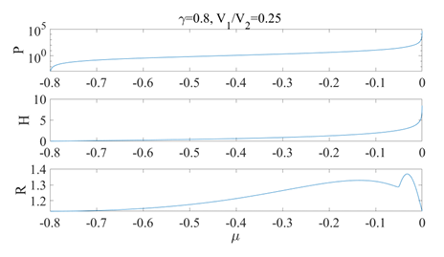
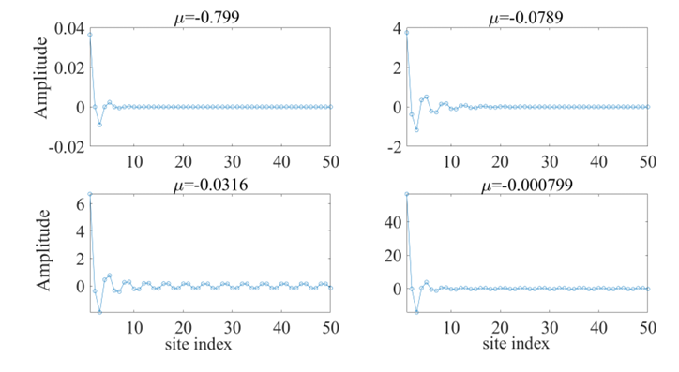
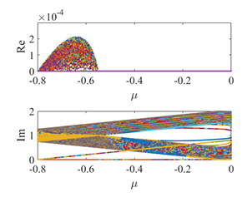
EXAMPLES: 1) Weakly resonant case:
γ < V₂*, t small - nonresonant regime,
tail resonances: 1 − t < γ
Fig. 3 NEM amplitude profiles in weakly resonant regime, γ=0.8, t=0.25. P, H and participation ratio (R) (up/right).
The real and imaginary parts of the instability EVs (right/down).
µ ~<-0.05: from B1H to B2L, EM widens keeping the exponential tail; further the oscillatory pattern appears→
µ ~ 0: near edge amplitudes rapidly increase due to nonlinear saturation
Rescaling the amplitude, NEM in the strongly saturated regime µ ≈ 0, in spite of the nonzero tail possesses essentially the same shape as LEM with µ ≈ −γ
* V₂=1 in the following

Slide 14
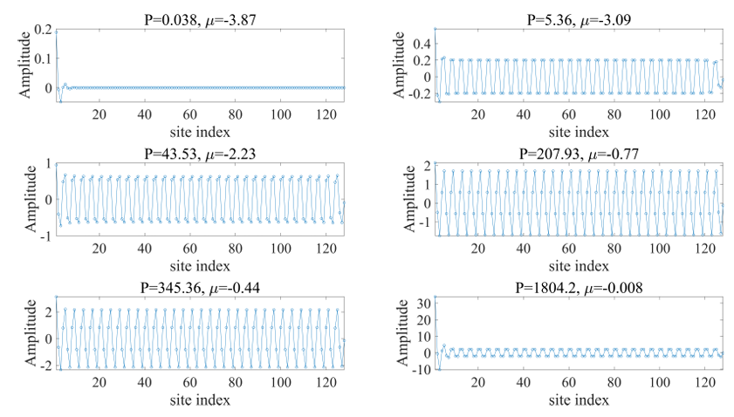
2) Strongly resonant regime γ > 1
Fig. 4 NEM amplitude profiles in strongly resonant regime: γ=4, t=0.25, V₂ =1
.
γ > 1 : increasing µ → regime of resonance with the upper linear band, for all t.
γ - tails grow, nontrivial tail reconfigurations;
NLM picks up the tail corresponding to the k = π band edge mode, with identical amplitudes on sites connected by V₂, v_{n}−1 ≈ u_{n} ≈ −v_{n} ≈ −u_{n}+1 when 4 ≲ n ≲ N − 3.
µ - mismatch at the right edge (u_{N}+1 = 0) affects the tail breaking the symmetry between u and v

Slide 15
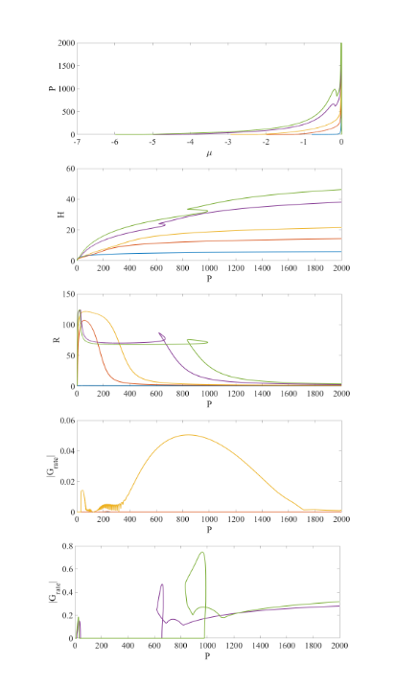
P(μ),H,R vs. P non-monotonic behavior indicates
bifurcation-induced tail reconfiguration.
Hysteresis loops indicate nontrivial internal
reorganization of mode’s tail structure
Tail shape transitions from symmetric to asymmetric
and vice versa through a hysteresis regime.
Mode transitions align with bifurcation points and
instability windows
Topological indicators are meaningful only
within dynamically stable, homogeneous regimes
Fig. 5 P, H, R, maximum growth rate G for
γ = 0.8, 2, 2.95, 5, 6 (blue, red, orange, violet and green)

Slide 16
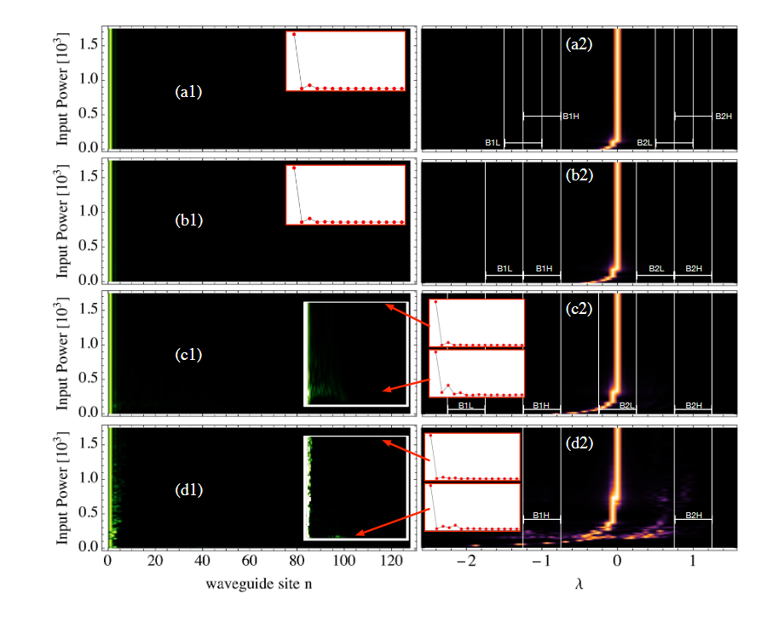
Confirmation of NEM robustness: Dynamical edge excitation
We run all simulations up to z_{max} = 100, and plot the output intensity profiles as function of input power using simply shaped initial profiles:
- analytical LEM
Fig. 6 LEM excitation, t=0.25 γ=0.25 (a) , 0.5 (b) , 1 (c) , 5 (d). N=64, P(z_{max}) vs P(0)
and Fourier spectrum. B1L,B1H and B2L,B2H –boundaries of linear low and high amplitude
bands.

Slide 17
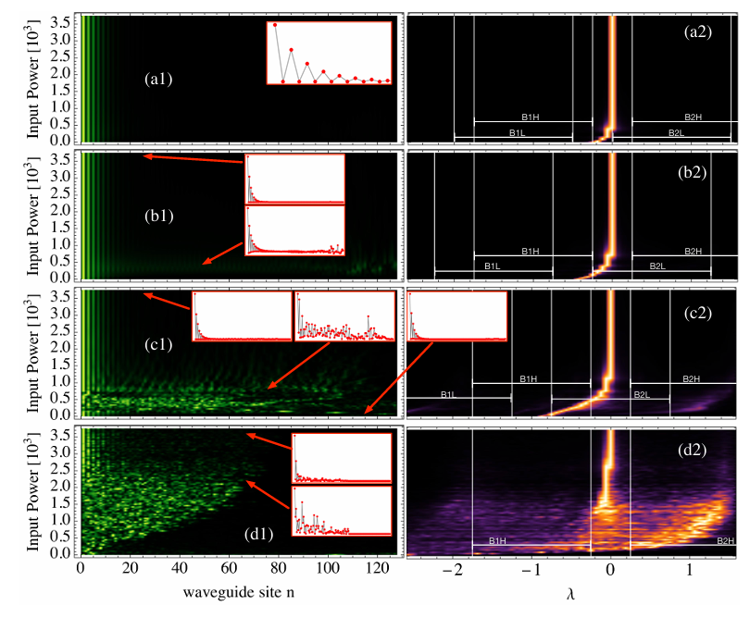
Fig. 7 LEM excitation, t=0.75, γ=0.25 (a) , 0.5 (b) , 1 (c) , 5 (d). N=64, P(z_{max}) vs P(0)
and Fourier spectrum. B1L,B1H and B2L,B2H –boundaries of linear low and high amplitude
bands.

Slide 18


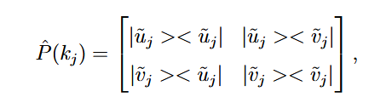

What is about BULK-EDGE correspondence?
Dynamical bulk excitations – determination of Zak phase
Zak-phase ⬄ Berry phase describing how a global phase accumulates as a complex Bloch eigenvector is carried around a closed loop in the k space inside the 1st Brillouin zone.
1) MFD* of the center of mass of the wave packet :
(7)
2) Projector matrix, consists of projectors onto states in the 1st Brillouin zone:
(8)
* Originally tracking the center of mass of the Wannier functions (basis complementary
to the Bloch functions in 1D linear periodic systems [13])

Slide 19
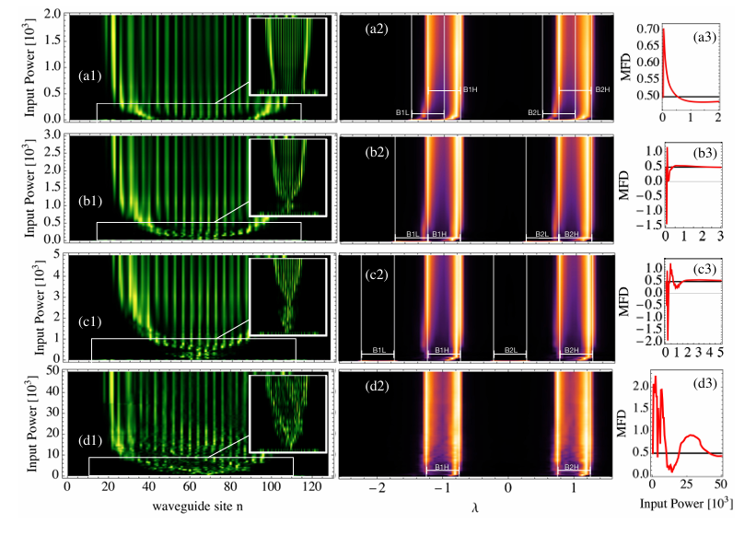
MFD Method: Single middle bulk site excitation;
= low P (insets)– diffraction; high P – spreading of structure slowly increases and saturates
=Freq. domain: homogenously populated linear bands →
localization in-between the low- and high-power bands→ inside the high-power linear bands
= MFD ~ 0.5→ Zak phase 1[π] in low P regime
Fig. 8 Strong dimerization t=0.25 for (a) γ = 0.25, (b) γ = 0.5, (c) γ = 1.0, and (d) γ = 5.0. Intensity output profiles at z_{max} = 100 and excited Fourier spectrum vs. input power P. The1st and 2nd linear band in the low- and high-amplitude limits : B1L, B2L, B1H, B2H + MFD plots.

Slide 20
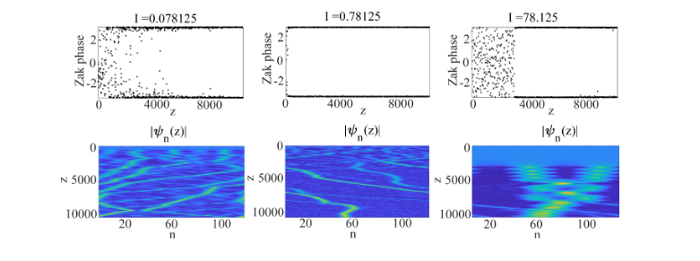
Projector method using modulational instability (MI)
Weak NL: MI may result in a sufficiently smooth distribution of Fourier components in k-space for the projector method to give an accurate approximation of the Zak phase after some propagation distance.
Fig. 9 Zak phase (top) γ=0.25 and selected input intensities I. Total power are: P=10,100,10000
Nonresonant regime (γ<1−t​):
Lower and upper bands well separated
Smooth power continuation within each subband (B1L → B1H, B2L → B2H)
Well-defined Zak phases at both low and high powers

Slide 21
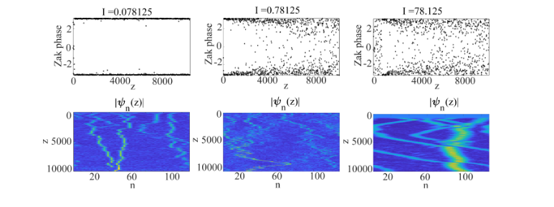
Fig. 10 Zak phase (top) γ=1 and selected input intensities I. Total power are: P=10,100,10000
Weakly resonant regime (γ≈1​):
Subband separation decreases
Inter-band mixing increases with power:
Zak phase stability begins to degrade

Slide 22
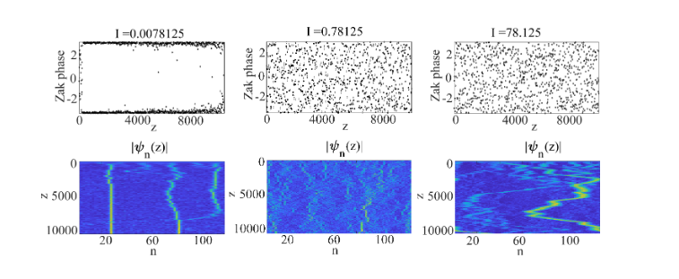
Fig. 11 Zak phase (top) γ=5 and selected input intensities I. Total power are: P=10,100,10000
Strongly resonant regime (γ>>1):separation between low-amplitude and high-amplitude linear bands is larger than the separation between upper and lower
Inter-subband mixing becomes dominant: Zak phases only persist at very low powers
At high P inhomogeneity acts against topology

Slide 23
Conclusion:
We discovered regime-dependent Zak phase behavior in the
saturable nonlinear SSH model, which indicates the
absence of strict bulk-edge correspondence.

Slide 24
IV SUMMARY
Saturable nonlinearity bridges two linear regimes
Three nonlinear edge mode regimes:
Nonresonant — well-localized, topologically protected
Weakly resonant — tails develop, topological indicators degrade
Strongly resonant — strong mixing, loss of topological signal
Topology remains meaningful only in stable, homogeneous dynamical settings
No strict bulk–edge correspondence

Slide 25
Future directions:
Develop experimental protocols to reach and isolate the saturable regime
Extend the concept of bulk–edge correspondence to dynamically evolving nonlinear systems
Explore Floquet driving

Slide 26
References:
[1] Smirnova et al., Phys. Rev. Lett., Phys. Rev. A (2019–2020)
[2] Kruk, Nonlinear topological photonics, Advances in Nonlinear Physics (2023)
[3] Leykam, Smirnova, Maluckov, PRL (2020)
[4] Zhou, Nat. Commun. (2022); PRB (2022)
[5] Maczewsky et al., Nat. Photonics (2017)
[6] Su, Schrieffer, Heeger, Phys. Rev. Lett. (1979)
[7] Hadad PRB 2016, ACS Photonics 2017
[8] Sone, Ezawa, Nat. Phys. (2024).
[9] Vicencio, Johansson, PRA (2009).
[10] Bugarski, Maluckov, Vicencio, Johansson, Chaos, Solitons and Fractals 193 , 116086 (2025).
[11] Azboth, Oroszlany, Palyi, A Short Course on Topological Insulators (2015)

Slide 27
The Participation Number captures this transformation:
Low R: Localized modes (sharp edge)
High R≈2N: Homogeneous-like tails
Return to low R: Edge-localized structure reappears
Strong γ (e.g. γ=5) yields a plateau in R, confirming a nonhomogeneous tail configuration
with ∣v_{n}∣<∣u_{n}∣.

Slide 28
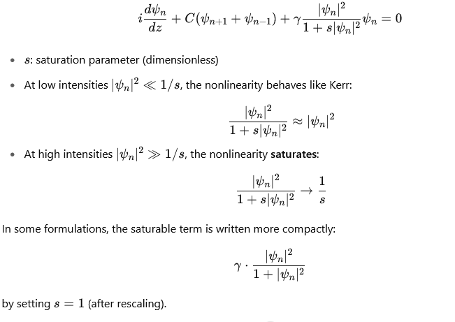

Slide 29
Bipartiteness: Structural Property
A bipartite lattice is a graph or network whose sites (nodes) can be divided into two disjoint sets (say, A and B), such that all couplings (edges) connect A sites to B sites only, and never A-to-A or B-to-B.
In the SSH model, this means you have alternating sites (A–B–A–B…) with couplings only between different sublattices.
Bipartiteness is a geometric or topological property of the lattice graph.
Chiral Symmetry (a.k.a. sublattice symmetry): Hamiltonian Symmetry
A chiral symmetric Hamiltonian satisfies:
ΓHΓ⁻¹=−H where Γis a unitary operator (usually diagonal), such as:
Γ=(IA 0 // 0 −IB
This symmetry implies that the spectrum is symmetric around zero energy (or zero propagation constant in photonics), i.e., for every eigenvalue E, there is a −E-.
Chiral symmetry prevents on-site potential terms within a sublattice (no A↔A or B↔B coupling or on-site energy).
In the SSH model:
The bipartite structure ensures that the Hamiltonian has no intra-sublattice couplings.
This structural feature naturally leads to chiral symmetry.
Hence: in tight-binding models with zero on-site energies, bipartiteness implies chiral symmetry.

